Slide 1
When Do I Need
to Use Deep Learning ?
This will give a brief overview of when deep learning is used,
and provide a discussion around when you actually need
to build deep learning models from “scratch”

Slide 2
“Deep Learning” are modern methods of creating Machine Learning Systems.
Machine Learning Systems = Prediction Machines.
Deep Learning (DL) takes its name from Deep Neural Networks.
Artificial Neural Networks were inspired
by progress in brain research and were discussed since 1950s.

Slide 3
Recent breakthroughs in DL methods
made them practical
(effective, affordable, and easy).
Instead of software engineers manually coding if/else logic,
DL algorithms can train networks equivalent to millions or billions of if/else-s.
(Record of year 2020 – 175 Bln nodes).
Nowadays you can choose from a variety of pre-trained / pre-configured networks on the cloud.

Slide 4
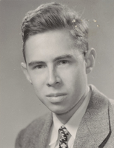
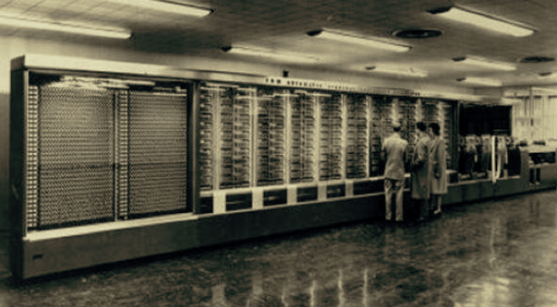
Single Layer Perceptron
Frank Rosenblatt
(1928-1971)
Single-Layer Perceptron - 1957
The machine was connected to a camera that used
20×20 photocells to produce a 400-pixel image.

Slide 5
Perceptron
(Single Layer)
Deep Network
Multilayer Perceptron

Slide 6
Neural Networks Leverage “Multiplicative” Complexity
Chess board example:
1
2
4
8
…
N_{k} = 2*N_{k-1}
2⁶⁴ ~ 10¹⁹

Slide 7
Deep Learning – using layers to achieve “multiplicative” complexity
x
y = f(x)
If sequential layers are fully interconnected, then number of connections ~N*N*(L-1), and complexity ~ N^{L-1}, (N = size, L = number of layers). So if N=L=20, then Ncon =~ 8,000, Ncompl =~20¹⁹ =~ 5*10²⁴ .
Note: Logic is stored in weights of connections (W-coefficients), and biases (b-shifts). Note: we need non-linearity in nodes, otherwise the network is equivalent to a simple linear function.

Slide 8

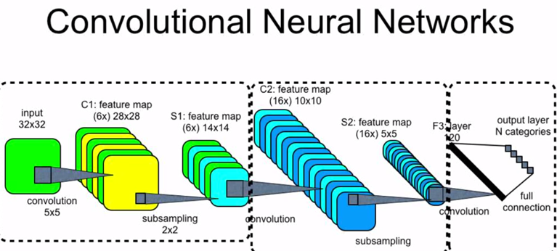
First successful practical networks were created 30 years ago.
1989 - Yann LeCun at AT&T in NJ,
Convolutional Neural Networks
Yann LeCun
(NYU, FB)

Slide 9

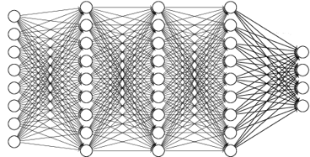

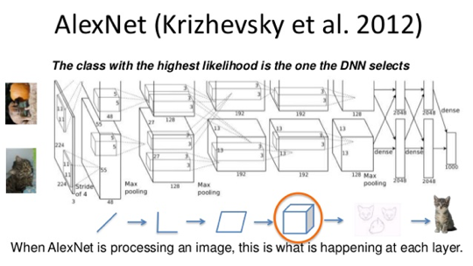
2006
Restricted Boltzmann Machine
Deep Belief Network
Lots of progress was done
in Geoffrey Hinton's lab
at University of Toronto, Canada
Geoffrey Hinton
Alex Krizhevsky
AlexNet – re-implemented LeNet on GPU, 2012

Slide 10

Since then we have seen tremendous growth and acceptance of Deep Learning in many areas.
Especially in the area of "AI" (Artificial Intelligence).
AI means using Deep Learning techniques to perform operations which usually are associated with human-level intelligence. Like playing games or driving cars.
Many classes of DL systems were developed, like:
CNN (Convolutional Neural Network),
RNN (Recurrent Neural Network),
LSTM (Long Short-Term Memory),
GRU (Gated Recurrent Unit),
GAN (Generative Adversarial Network),
BERT (Bidirectional Encoder Representations from Transformers),
RL (Reinforcement Learning),
and many others.
GPT-3 Language Model
175 Billion Parameters

Slide 11
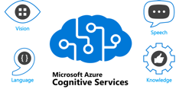
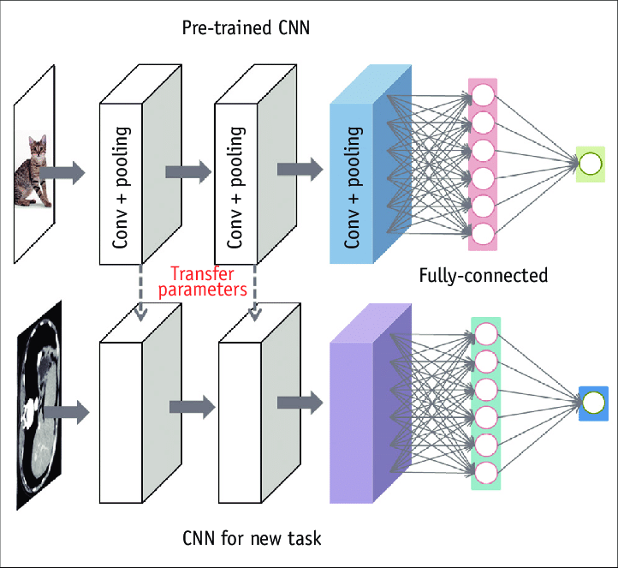
All major clouds and many 3rd party vendors nowadays provide many kinds of pre-trained Deep Learning models as well as infrastructure to use them.
You can use them "as is" (Cognitive Services).
Or you can fine-tune the models by additionally training on your own data ("Transfer Learning").
Wide availability of pretrained models made Deep Learning affordable and practical for many cases.
Typical examples are tasks like speech-to-text, translation, chat-bots, image classification, or anomaly detection.
In most cases there is no need in doing "heavy lifting" of designing and training a Deep Learning model from scratch.

Slide 12
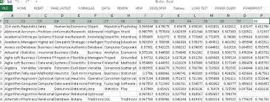
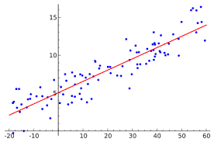
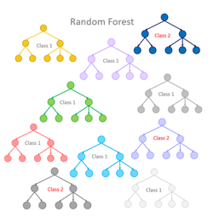
Tabular Data
Note that most of the common Data Science tasks do not even require developing custom Deep Learning models at all.
Most common data format is tabular data (Excel, Relational Databases). Typical tasks may include predictive analytics, forecasting, trends, investments, optimization of business processes, recommender systems.
These tasks usually can be easily solved using "classical" Machine Learning methods like regression (Linear, Logistic) or Ensemble Decision Trees (Random Forest or Boosted Trees).

Slide 13

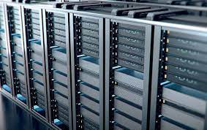
Other common tasks can be solved using cloud Cognitive Services.
Typical tasks may be face recognition, speech to text conversion, NLP (Natural Language Processing), customer service chatbots.
Cognitive services tend to be costly.
In these cases it is often recommended to use open-source tools on Linux servers. Cloud can be still used for fast prototyping of the model.
To further decrease the cost it is recommended to use a Private Cloud with GPU-enabled servers running some open-source Machine Learning Software, like KubeFlow, TensorFlow, Scikit-Learn, PyTorch, etc.
Note that there are also certain areas where custom models may be still required. Examples may be related to detection of something.
For example, detection of defects in manufacturing, fraud detection, anomaly detection. In most of these cases it is possible to use pre-trained models, which makes training/re-training the models cheap and fast.

Slide 14
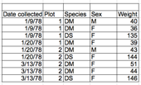



Conclusions
Most of Data Science tasks are based on Tabular Data and don't require Deep Learning.
Many of complex tasks were already solved and available for you on major clouds (Google Translate, Azure Cognitive Services, etc.) – although these solutions tend to be costly.
For some tasks when Deep Learning is needed, it can be prototyped very fast on major clouds using pre-trained models and transfer learning.
For cost savings, the Deep Learning models can be moved to a private cloud.

